Slide 1
Backup of Azure VMs
Notes:
IMPORTANT NOTE:
Microsoft Ready will utilize Windows 10 and the new PowerPoint 2016, as well as PowerPoint 2013 on all event machines. Please build your slides utilizing the appropriate Template and utilize the version of PowerPoint that works best.
Windows 10 devices now connect remotely through VPN using the PIN with Passport for Work. Speakers needing to use VPN in a demo, will need to have registered for Phone Authentication at https://phoneregistration.microsoft.com. Additional details are also available here: https://microsoft.sharepoint.com/sites/itweb/securelogon/Pages/FAQ.aspx

Slide 2
Azure Backup: A Quick Summary
Cloud-first Backup Solution
Built as a Native Cloud Service – Infrastructure free!
Protect Linux or Windows VMs in Azure & On-premises
Flexible long term retention policy
Instant file recovery
Centralized Management and Reporting
Backup of Encrypted VMs

Slide 3
Cloud backup approach
Azure Backup approach is differentiated!
Cloud as storage target
Backup software in IaaS
Azure Backup Approach
On-prem infrastructure
License costs for Windows
License costs for backup software
Egress costs $0.087-$.181/GB
Cloud Compute cost $536/mo
License costs for Windows
License costs backup software
Max storage 32TB per VM
Backup as a Service
Pay as you go
No backup infrastructure
No additional compute costs
No egress costs for restore
Self service
Central management from cloud

Slide 4

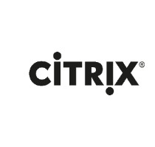
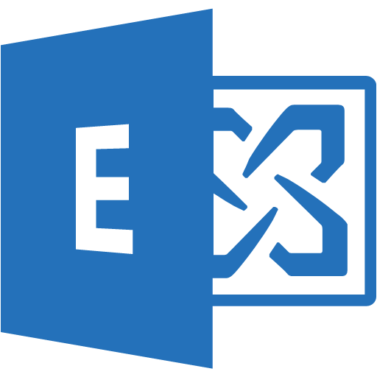

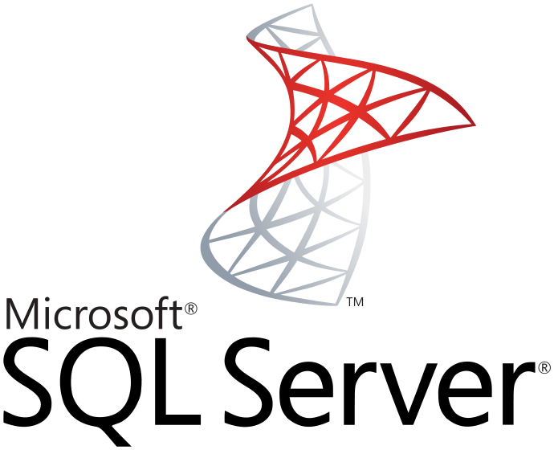
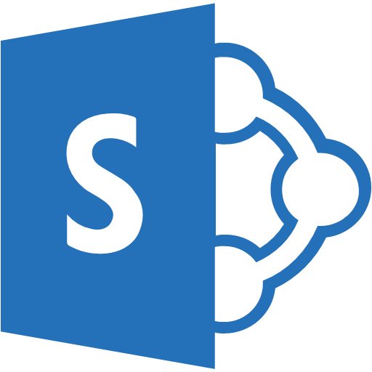





Protection of on-premises & Azure VMs
Heterogeneous Platform Support
Cloud 1st Service
Datacenter Extension
A true Public Cloud DR Service is on-demand, heterogeneous, and automated.
Data Replication forms a constant connection to the Public Cloud. Your data can become usable on demand for Recovery, Testing, or Migration.
Hyper-V & VMware - - > Azure
Physical Windows - - > Azure*
Windows & Linux Azure VMs
VSS Consistent
VM Snapshot-based
Item Level Recovery
Up to 99 years retention
Backup & Restore
Cloud Storage
Cloud Storage
Physical Windows Servers
Virtual Machines
Powerful protection that reduces infrastructure!

Slide 5




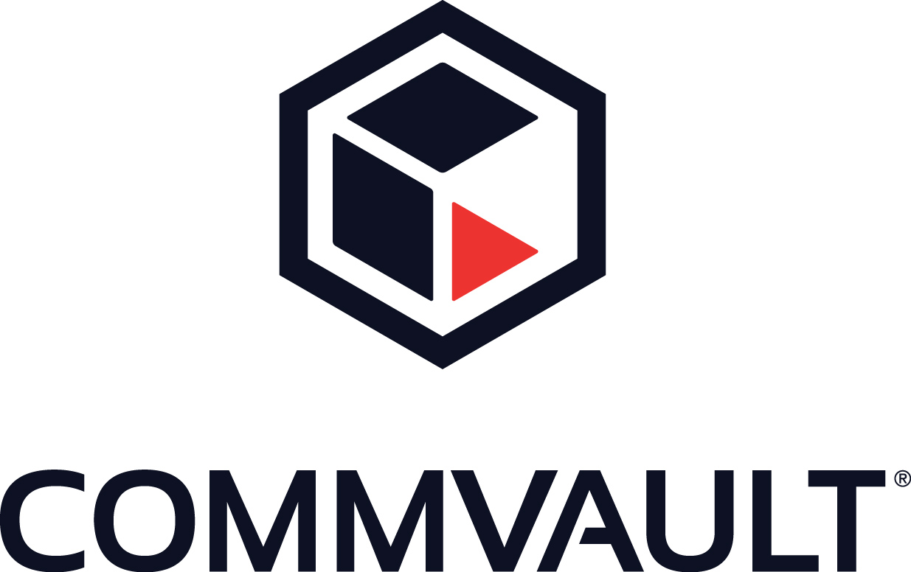







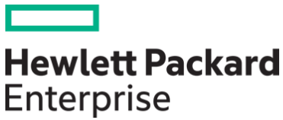
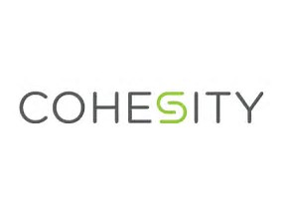
A Massive Ecosystem (this is just Backup)
Industry Leaders
Endpoints
Appliances
Emerging Vendors

Slide 6





Backup Decision Tree
Cloudboost
Avamar
Software
Hardware
Yes. Co-sell with ISV
Vendor
Customer is happy with current vendor?
Microsoft-centric or heterogeneous OS/apps?
Enterprise tape replacement
No
Focus?
Microsoft
Client backup
Azure Backup Agent
Azure Backup Server
Remote Office
Hardware or Software?
Microsoft and our partners recommend keeping some local backups to enable fast restores. If your customer is considering a backup appliance, or would like a software-agnostic solution, recommend the hardware partners above.
Azure Backup Server

Slide 7



Azure VM Backup Use Case
IaaS VMs
Microsoft Azure
Notes
Recover even deleted VMs
RBAC limited initially
Scheduled or ad-hoc
Backup Vault for metadata
Storage Accounts for backups
Encrypted in-flight & at rest
Can protect:
Windows & Linux
Microsoft Applications
Retention up to 99 years
Support matrix here
Now supporting v2 VMs and Premium Storage!
RBAC Mgmt
Customer 1 Subscription
Customer 2 Subscription
Customer 3 Subscription
Data Path
Data Path
Data Path
Azure VMs
Azure VMs
Azure VMs
Azure and Azure Backup Provide the Control Plane and backend for VM backup, catalog, and vaulting.
“The ONLY Enterprise Cloud Provider!”

Slide 8
Common limitations & objections
Limitation | Impact | Potential Workaround
Support for 3rd Party Applications | Lack of application consistency for Oracle, MongoDB, other Linux applications | Discuss native tools (RMAN) + Azure Backup to offsite Partner with 3rd Party (Commvault)
Desktop backup - Lack of centralized restores | Large scale client backups are unlikely with Azure Backup Agent | Leverage SC DPM or Azure Backup Server Partner with 3rd Party (Datacastle)
Cost of long term retention | GRS and even LRS perceived as expensive versus tape | Cool Storage support is coming! Emphasize ease-of-use, reliability, and time-to-restore
Customer invested in current solution | Cost and complexity of switching viewed as too high | Target limited apps, position a progression Target remote offices to begin
Lack of deduplication | Storage requirements perceived as higher than solutions with dedupe | Discuss our incremental forever efficiency and compression Cite dropping cost of cloud storage

Slide 9
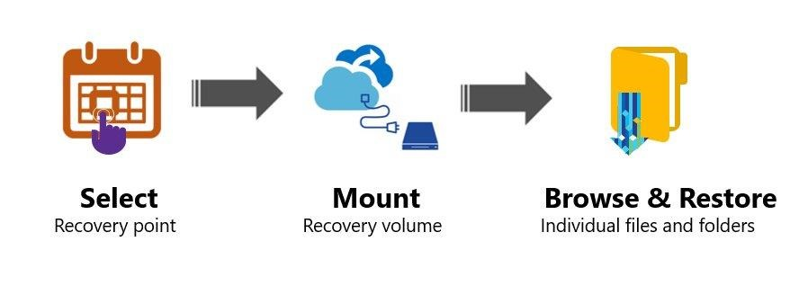
Backup - File Recovery
Select Recovery point
Script generated
iSCSI Client verified
Automated Cleanup

Slide 10
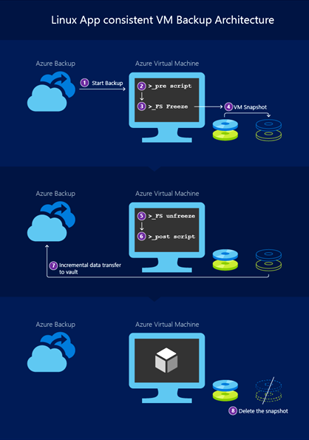
Backup - Application Consistency
1) Initiate Backup
2) Pre-script to Freeze IO
3) Take VM Snapshot
4) Post-script to thaw IO

Slide 11





Recent Updates Impacting Backup, Archive, & DR
Archive Storage & Object Tiering
Managed VM Disks
Blob REST API
Managed by Azure
Blob Storage Account
Hot
↑↑ Storage
↓↓ Access
Cool
↓ Storage
↑ Access
Archive
↓↓ Storage
↑↑ Access
OS Disk
Data Disk
VHDs
Managed Storage Accounts
Object-Level Tiering
50 Gb/s
50k iops
5PB
Limitless Storage Accounts
10-20 Gb/s
20k iops
500TB
Notes:
Object Level Tiering
Individual blobs can move between tiers
All tiers of blobs co-exist in a storage account
New Storage Tier – Archive Storage
Cold storage for long term data
Retrieval latency is hours
Consistent API among Storage tiers
Access through Blob REST API
Support direct writes to Archive
Azure Managed Disks for DR
Simple - Abstracts storage accounts from customers
Granular access control – Top level ARM resource, apply Azure RBAC
Storage account limits do not apply – No throttling due to storage account IOPS limits
Big scale - 20,000 disks per region per subscription
Better Storage Resiliency - Prevents single points of failure due to storage
Limitless storage accounts
Significant increase in size and performance and we are just getting started!

